Slide 1

Wireless Networks and MOBILE Computing
BY Mr. VALENS NSENGIYUMVA
Communication Systems Engineer, Sweden
Telephone: 0787288628
Email: nvalens18@gmail.com

Slide 2
DAY 6: Digital Communication Overview, Modulation and Fidelity
Orthogonal Waveforms
Linear Combinations
Reception
How to Choose a Modulation
Intersysmbol Interference
Cost of Implementation and Channel Capacity
PAM, M-ary QAM and PSK, FSK, MSK
DAY 8: Channel Coding
Block Codes, Error Detection
System Performance and Costs

Slide 3
18.1 Orthogonal waveforms

Slide 4
18.2 Linear combination

Slide 5
Examples

Slide 6
18.3 RECEPTION
18.4 How to choose a modulation

Slide 7
18.4.How to choose a modulation

Slide 8
18.5. bandwidth

Slide 9
18.6 Intersysmbol interference

Slide 10
18.6
In telecommunication, intersymbol interference (ISI) is a form of distortion of signal in which one symbol interferes with subsequent symbols.
This is an unwanted phenomenon as the previous symbols have similar effect as noise, thus making the communication less reliable.

Slide 11
18.7. Cost Implementation
Coherent systems need carrier phase information at the receiver and the use the matched filters to detect and decide what data was sent while noncoherent systems do not. Non coherent reception assumes that the phase of the received signal is arbitrary rather than carefully controlled, and it is guaranteed to give the specified error-rate.

Slide 12
18.8 Channel capacity

Slide 13
18.8.

Slide 14
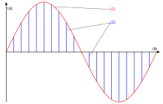
19. Modulation
PAM
Pulse-amplitude modulation (PAM), is a form of signal modulation where the message information is encoded in the amplitude of a series of signal pulse.
Principle of PAM: (1) original signal, (2) PAM signal, (a) amplitude of signal, (b) time

Slide 15
19.
PSK
Phase-shift keying (PSK) is a digital modulation process which conveys data by changing (modulating) the phase of a reference signal(the carrier wave). The modulation occurs by varying the sine and cosine inputs at a precise time. It is widely used for wireless LANs, RFID and Bluetooth communication.

Slide 16
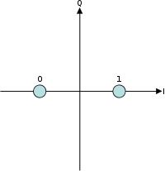
19.
BPSK ( Binary Phase Shift Keying) is the simplest form of (PSK). It uses two phases which are separated by 180° and so can also be termed 2-PSK.
It is, however, only able to modulate at 1 bit/symbol (as seen in the figure) and so is unsuitable for high data-rate applications. Constellation diagram example for BPSK:

Slide 17
19.
QPSK(Quadrature phase-shift keying)
Sometimes this is known as quadriphase PSK, 4-PSK, or 4-QAM. (Although the root concepts of QPSK and 4-QAM are different, the resulting modulated radio waves are exactly the same.)
QPSK uses four points on the constellation diagram, equispaced around a circle. With four phases, QPSK can encode two bits per symbol, shown in the diagram.

Slide 18
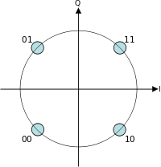
19.
QPSK
Given that radio communication channels are allocated by agencies such as the Federal Communication Commission giving a prescribed (maximum) bandwidth, the advantage of QPSK over BPSK becomes evident: QPSK transmits twice the data rate in a given bandwidth compared to BPSK - at the same BER.

Slide 19
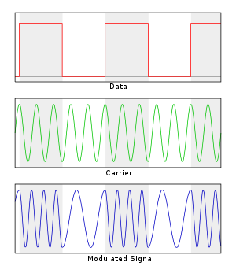
19.
FSK
Frequency-shift keying (FSK) is a frequency modulation scheme in which digital information is transmitted through discrete frequency changes of a carrier signal. The technology is used for communication systems such as amateur radio, and emergency broadcasts.

Slide 20
20. Fidelity
The fidelity(probability of bit error and probability of symbol error) across different modulations.
For the same energy per bit, using different modulation would result in different fidelity.

Slide 21
24. Channel coding
Forward error correction coding or channel coding
Adding redundancy to our data at the transmitter with the purpose detection and correcting errors at the receiver.
The transmitter takes in data bits and puts out coded bits.
Our notation is that for each k data bits input to FEC operator, the FEC operation will produce n > k coded bits out.

Slide 22
24.1. Examples of Error correction codes
Block code
Is an example of error correction code which is suitable for data that is not coming in large streams (bursty data sources <1000 bits ). E.g in wireless sensor networks.
Convolution code
This error correction technique is suitable for very large data streams. More energy efficient than block codes when you have large streams of data. E.g. in satellite and terrestrial digital video broadcasting.

Slide 23
24.2 Error Detection
Rather than to correct the data, can also simply try to detect the error. This lets us know not to use the data we’ve received.
If we request the data again, it tells the transmitter that we didn’t get the data (perhaps the SNR was too low or the interference power was too high), which it might need to know anyway. For error detection, we have the following packet structure:
1.Header: Information about who the data is meant for, what purpose the data is being sent
2. Payload: Data that we need to communicate.
3. Footer: Where the CRC is included.
The cyclic redundancy check (CRC) is a check to make sure that the data in the payload was correctly received.

Slide 24
THANK YOU

